Slide 1
SC1015 Data Science Presentation
Twu Pin Yang (U2121072C)
Lin Yung Chu (U2122123D)
Marco Nathaniel Lu Ng (U2120710J)
Notes:
1. Introduction to Problem Statement
2. Exploratory Analysis (Where data come from)
3. New Problem Definition

Slide 2
PROBLEM DEFINITION (WINE BUSINESS)
Costs
Predict
Business
Demographic
Reduce costs and maximise profits
Target a specific group to focus on advertising
Marketing costs would be wasted on customers who return lesser profits
Analyse data and produce a model to predict which customer segment spends the most

Slide 3
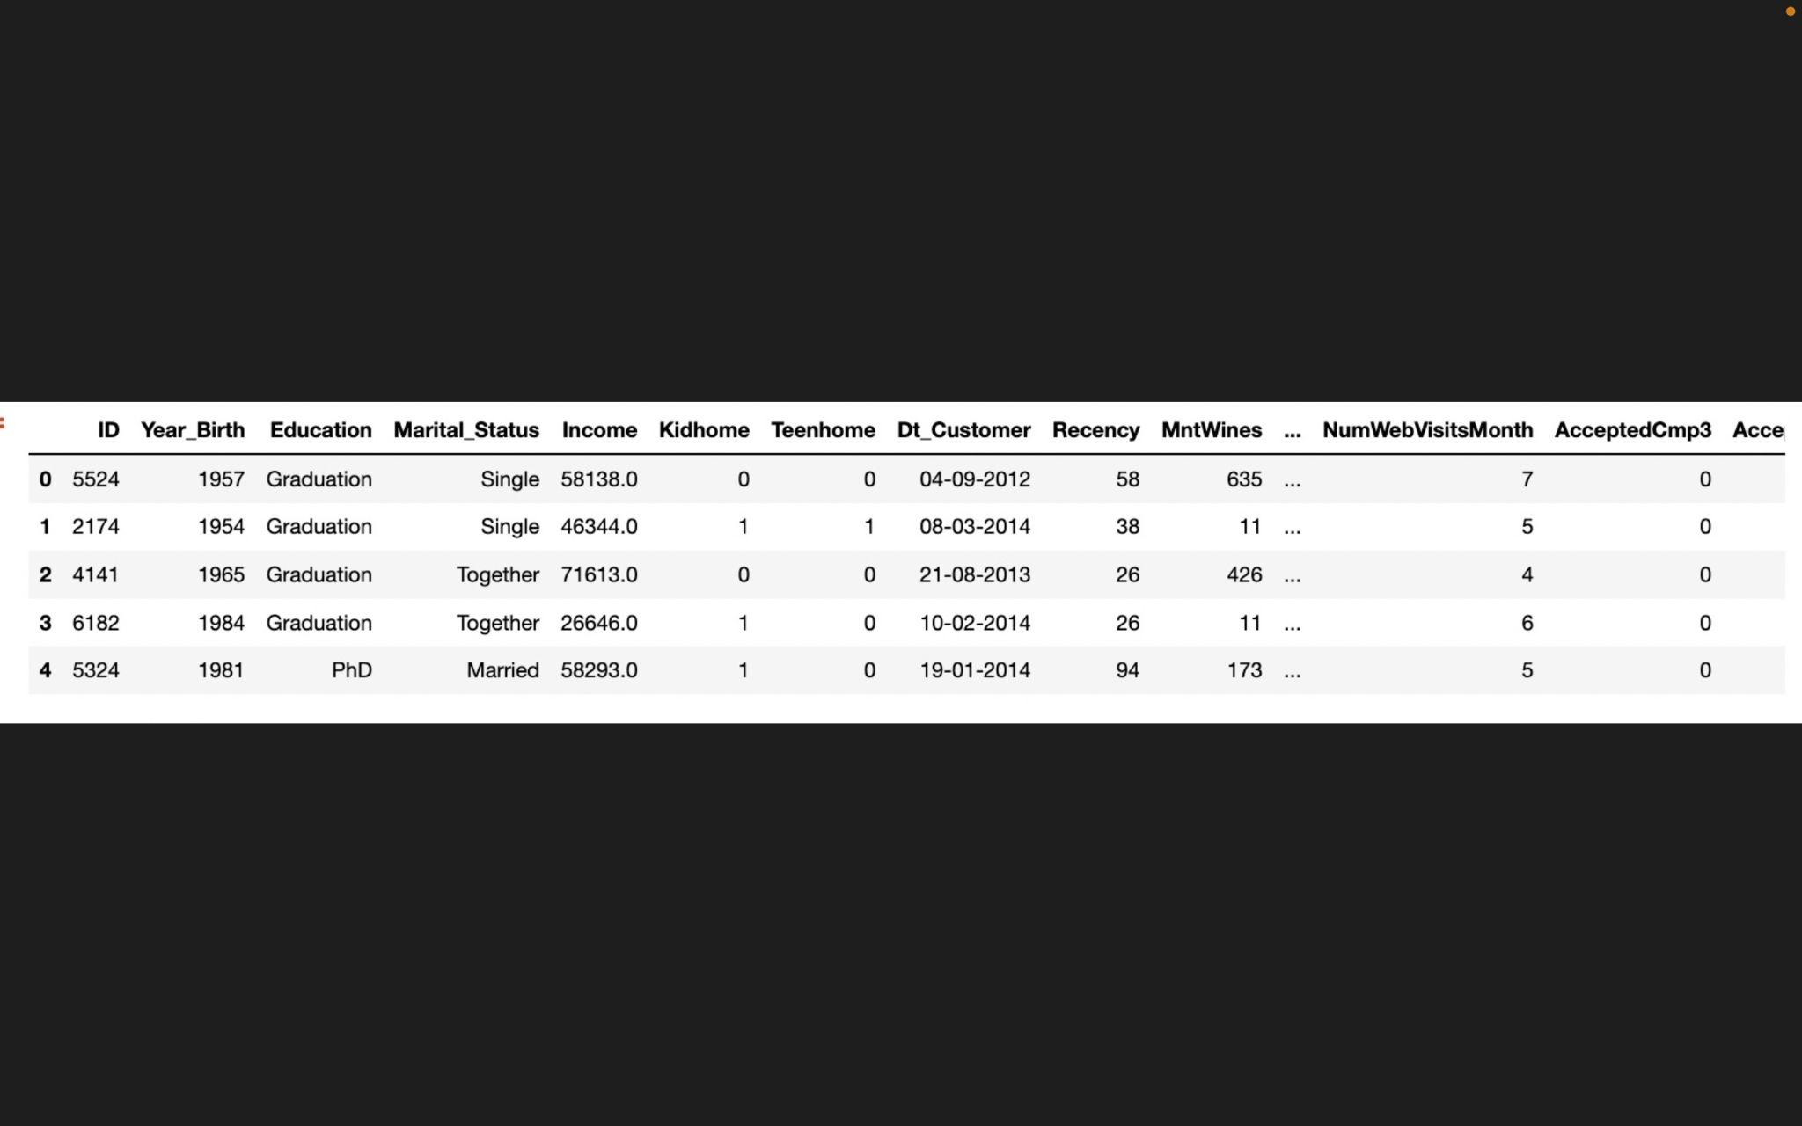
Dataset Used
Customer Personality Analysis Dataset (under Kaggle)
https://www.kaggle.com/code/willianhaeberlin/naive-bayes-classification/data

Slide 4
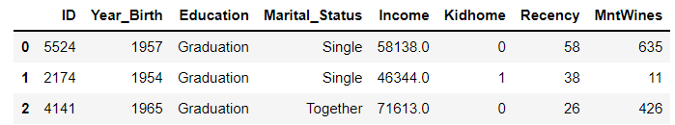
Data Filtering
(2240, 29)
(2240, 8)
Notes:
We realise that there are many irrelevant columns in the dataset, so we create a new dataframe with relevant columns that we think would help us.

Slide 5
Data Column Description
Year_Birth | Customer's birth year
Education | Customer's education level
Marital_Status | Customer's marital status
Income | Customer's yearly household income
Kidhome | Number of children in customer's household
Recency | Number of days since customer's last purchase
MntWines | Amount spent on wine in last 2 years
Notes:
Explain each columns

Slide 6
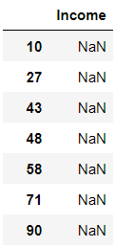
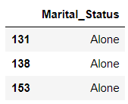
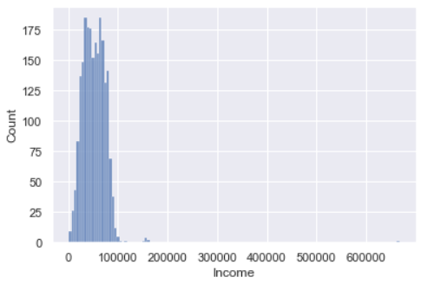

Data Cleaning
Weird Values
NaN
Outliers
Notes:
We found out that there are 24 NaN values in the Income Column, So we remove them.
There are some values in Marital Status column that do not make sense. So we replace them with a logical value.
There are outliers in some columns like Income, So we remove them.
The reason why we remove them is because we have more than sufficient data (2240).

Slide 7
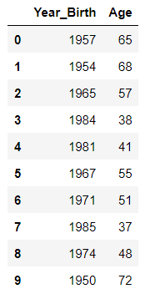
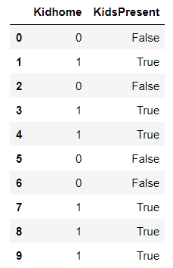
Data Preparation
>= 1 Kid at Home will return True
Create Age column
Create KidsPresent column
(Categorical Variable)

Slide 8
Explore the relationship between amount spent on wine (in 2 years) and other variables

Slide 9
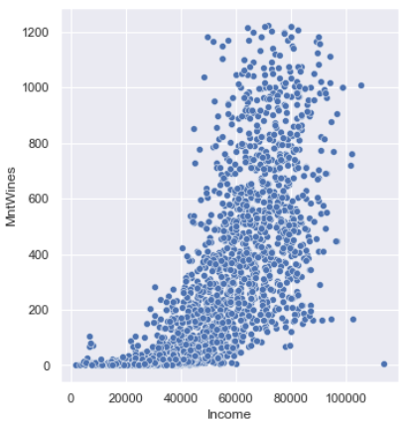
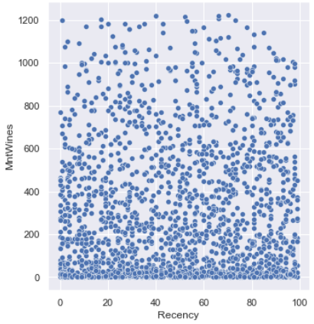
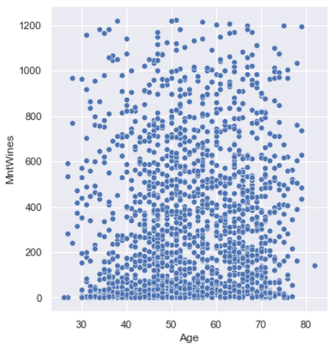
Relationship with numerical variable
Income
Recency
Age
There is a evident relationship between
income level and the amount spent on wine
Notes:
Scatterplot

Slide 10
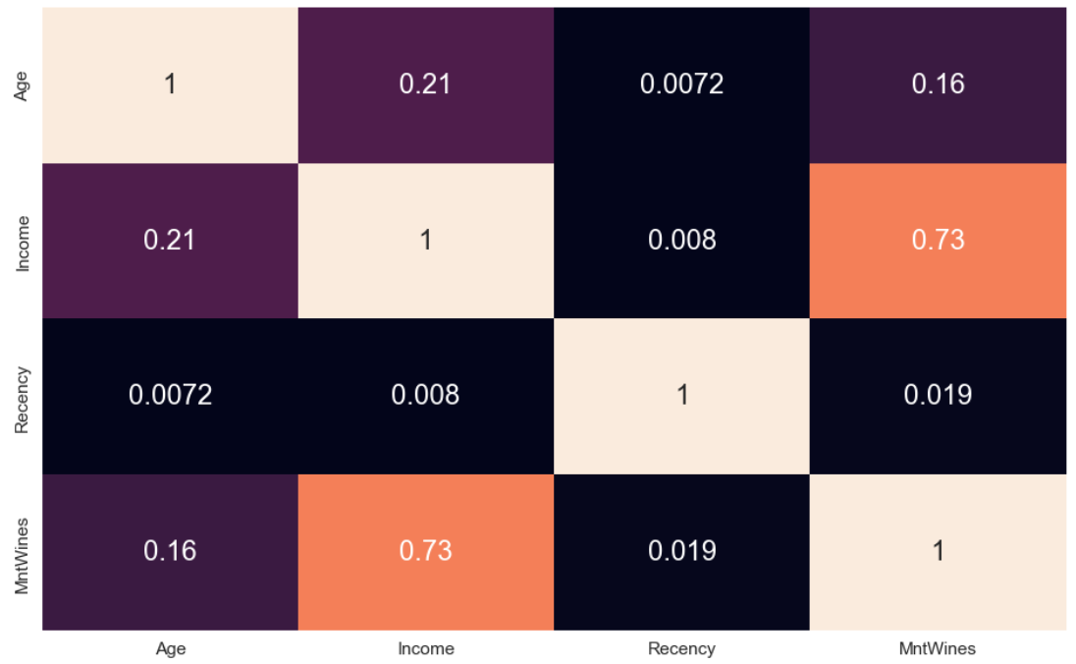
Correlation Heatmap
0.73 implies strong relationship
between Income and MntWines

Slide 11
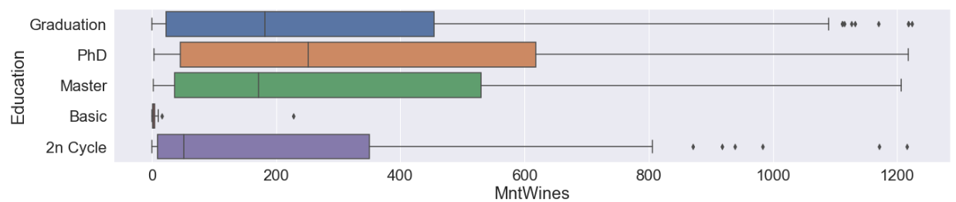
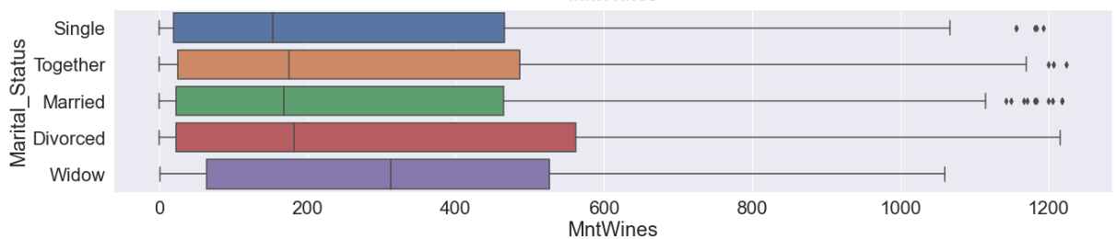
Relationship with categorical variable
weak relationship between Education/Marital Status and the amount spent on wine
Notes:
Boxplot

Slide 12
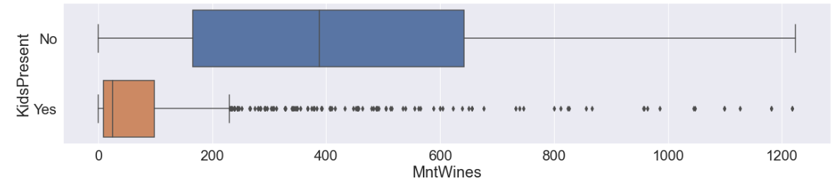
Relationship with categorical variable
strong relationship
between Kids Present and the amount spent on wine

Slide 13
Using Income, Recency, and Age to predict likelihood of a customer to buy wine

Slide 14
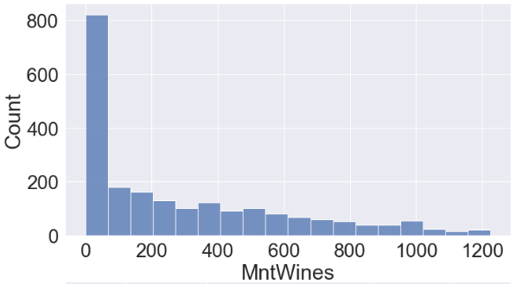
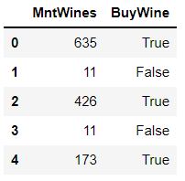
Data Reclassification
30%
70%
(Buy Wine)
Create a new column
on whether a person is likely to buy wine after being targeted (based on the amount they spent on wine)

Slide 15
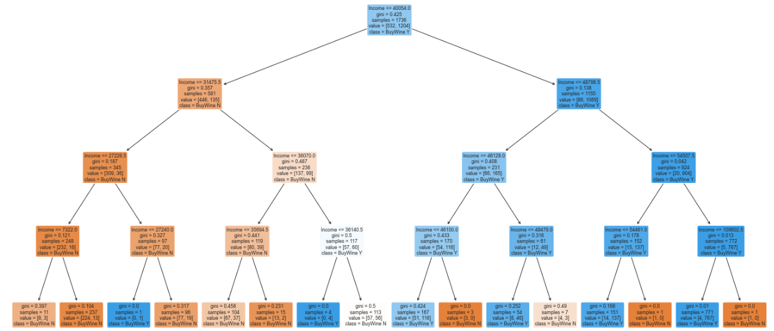
Decision Tree Classification
Used to classify a categorical response variable (Buy wine) using numerical predictors (Income)
Left side is generally lower income and do not buy wine, while right side is generally higher income and buy wine

Slide 16
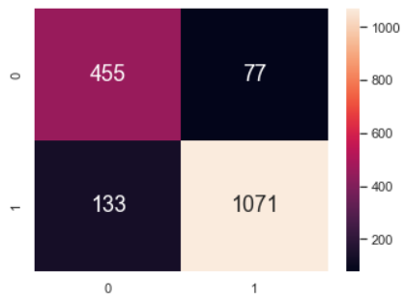
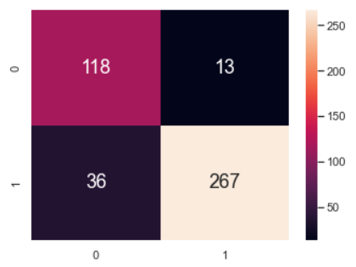
Goodness of Fit
Train Dataset
- Classification Accuracy: 0.879
- True positive rate: 0.889
- False positive rate: 0.142
Test Dataset
- Classification Accuracy: 0.887
- True positive rate: 0.881
- False positive rate: 0.110
Train Dataset
Test Dataset

Slide 17

Other Model
Different tree model using Recency and Age
Results
Best Model: Income
(since the model has the highest classification accuracy for train/test dataset)
Income has the highest correlation with amount spent on wine
Decision Tree Model using Recency
- Classification Accuracy (Train): 0.695
- Classification Accuracy (Test): 0.705
Decision Tree Model using Age
- Classification Accuracy (Train): 0.700
- Classification Accuracy (Test): 0.691
Decision Tree Model using Income
- Classification Accuracy (Train): 0.879
- Classification Accuracy (Test): 0.887

Slide 18
Data Insights
The higher the income, the more likely a person would buy wine
Probable reason:
Wine is expensive and a luxury good. Higher income will mean higher purchasing power for wine.
Recency and Age have little effect on the likelihood of a person buying wine

Slide 19
K Means Clustering
An algorithm to find groups
which have not been explicitly labelled in the data
How we use it:
We split our customers into different groups based on their income level

Slide 20
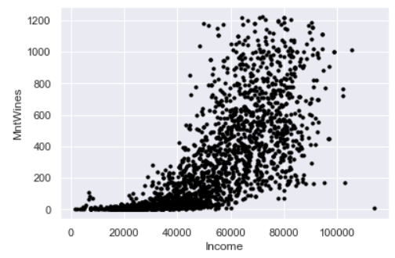
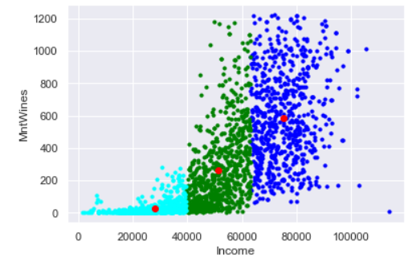
K Means Clustering
Notes:
We use K Means Clustering to split the Income group into three different customer segments.

Slide 21
Data Insights
Different income groups have different spending ranges for wine
Higher income group tends to have wider spending range for wine
Probable Strategy: For higher income group (>62,000), target those that spent >600 on wine.

Slide 22
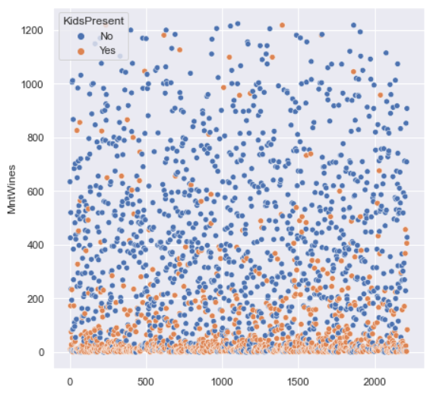
Data Insights
Household with Kids at home generally spend LESS amount on wine
Probable Reason: Do not want kids to be exposed to unhealthy alcohol habit

Slide 23
Outcome of Project
For our next marketing campaign, we should market wine towards households with:
No Kids at home
High disposable Income
This way we can narrow down our campaign scope and cut costs, this makes our campaign more:
Cost-Efficient
Effective

Slide 24
Thank you!!!
Notes:
1. Introduction to Problem Statement
2. Exploratory Analysis (Where data come from)
3. New Problem Definition

